Slide 1
Energy Grid Telemetry Platform
CSCI 414/514 · Option 09 · Final Project
Network, security, monitoring and recovery for a smart-meter data pipeline
Chidera Izuora · Teagen Lee · Yohannes Nigusse
github.com/TeagenLee/csci414-energy-grid
Notes:
Hey everyone, we're Chidera, Teagen and Yohannes. Our project is an energy grid telemetry platform. A meter sends readings through a router to a TLS API and into a database. We built it, locked it down, and tested it on a normal run, a congested link and a failure. (Roles: confirm each person's part against the git history.)

Slide 2
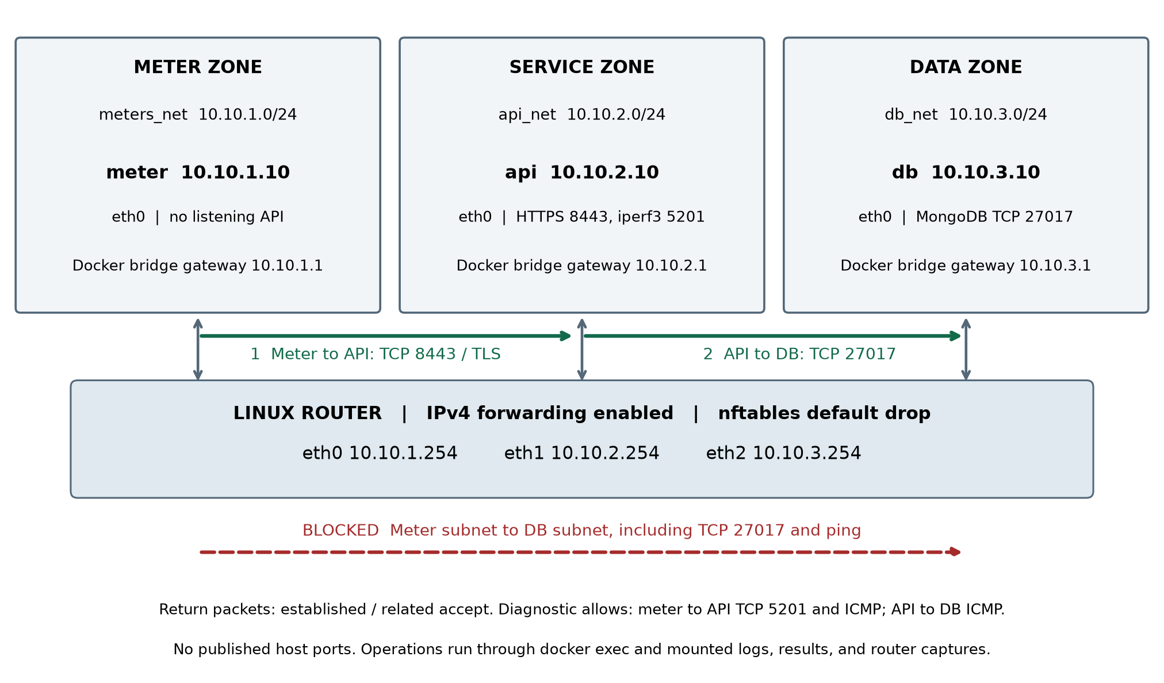
Network Architecture
Module A · Network
Four containers: meter, router, api, db
Three subnets: 10.10.1.0/24, 10.10.2.0/24, 10.10.3.0/24
The router sits at .254 and forwards IPv4
nftables drops everything by default
Notes:
Start on the left. The meter can only talk to the API zone. The router forwards between subnets and drops anything we didn't explicitly allow. We also didn't publish any host ports.

Slide 3
Data Flow
Modules B and A · Distributed service
1 · Meter
2 · Router
3 · API
4 · Database
Sends batches of UCI household power readings over HTTPS to 10.10.2.10:8443
Matches our allow rule, forwards the traffic, and counts packets
FastAPI over TLS 1.3 checks the batch and writes it to MongoDB
MongoDB 7.0 stores the readings and the API sends back a 201
Dataset: UCI Household Electric Power Consumption (CC BY 4.0), 20,000 rows imported, plus a synthetic solar model
Notes:
This is one batch from start to finish. The meter POSTs it, the router forwards it, the API checks it and stores it in MongoDB, and then the 201 comes back. Every measurement later uses this same path.

Slide 4
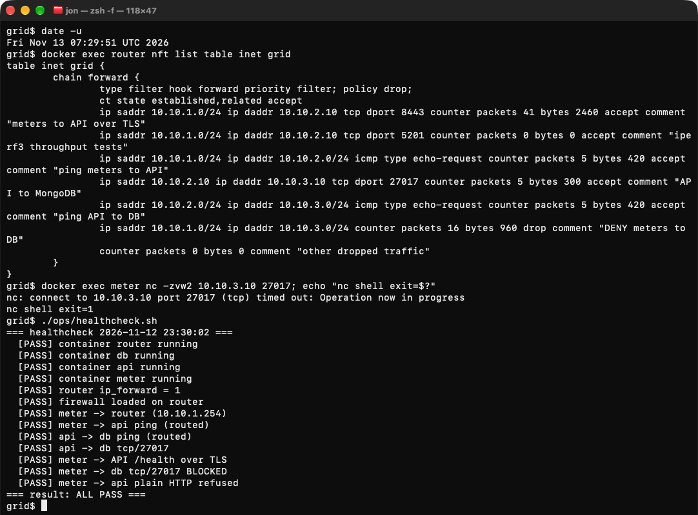
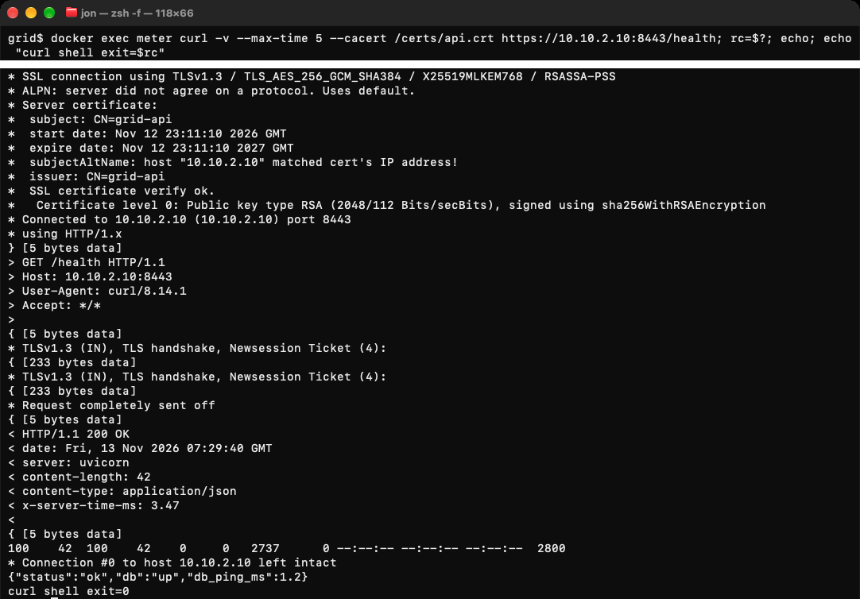
Security
Module C · Security
Meter to API on TCP 8443 works. Meter to the DB on 27017 is blocked on purpose
TLS 1.3, and the certificate covers 10.10.2.10 and the name api
Evidence: nft ruleset, nc timeout to DB, curl -v handshake, healthcheck 13/13 PASS
Notes:
First the ruleset, then the nc from the meter to the database timing out, then the TLS 1.3 handshake. Our healthcheck runs 13 checks and all of them passed.

Slide 5
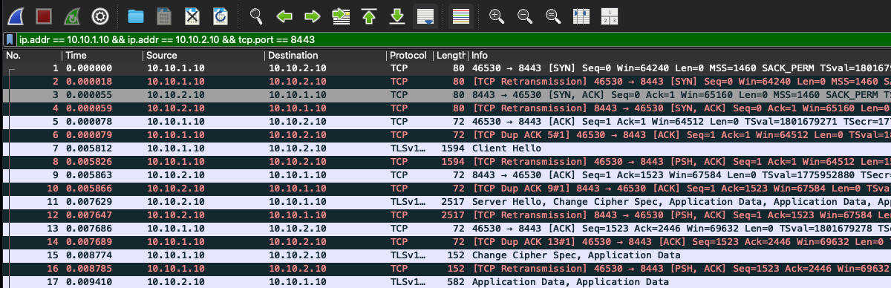
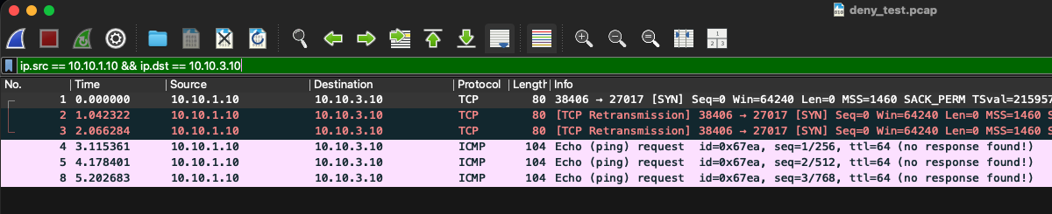
Packet Capture and Logs
Module D · Observability
Top: the TCP and TLS handshake from the meter to the API
Bottom: meter to DB attempts fail and never reach the database
The API log, router counters and capture all line up in time
Notes:
The handshake succeeds on the allowed path and the blocked path only produces errors. We checked this with tcpdump on the router and Wireshark, and the API log timestamps matched.

Slide 6
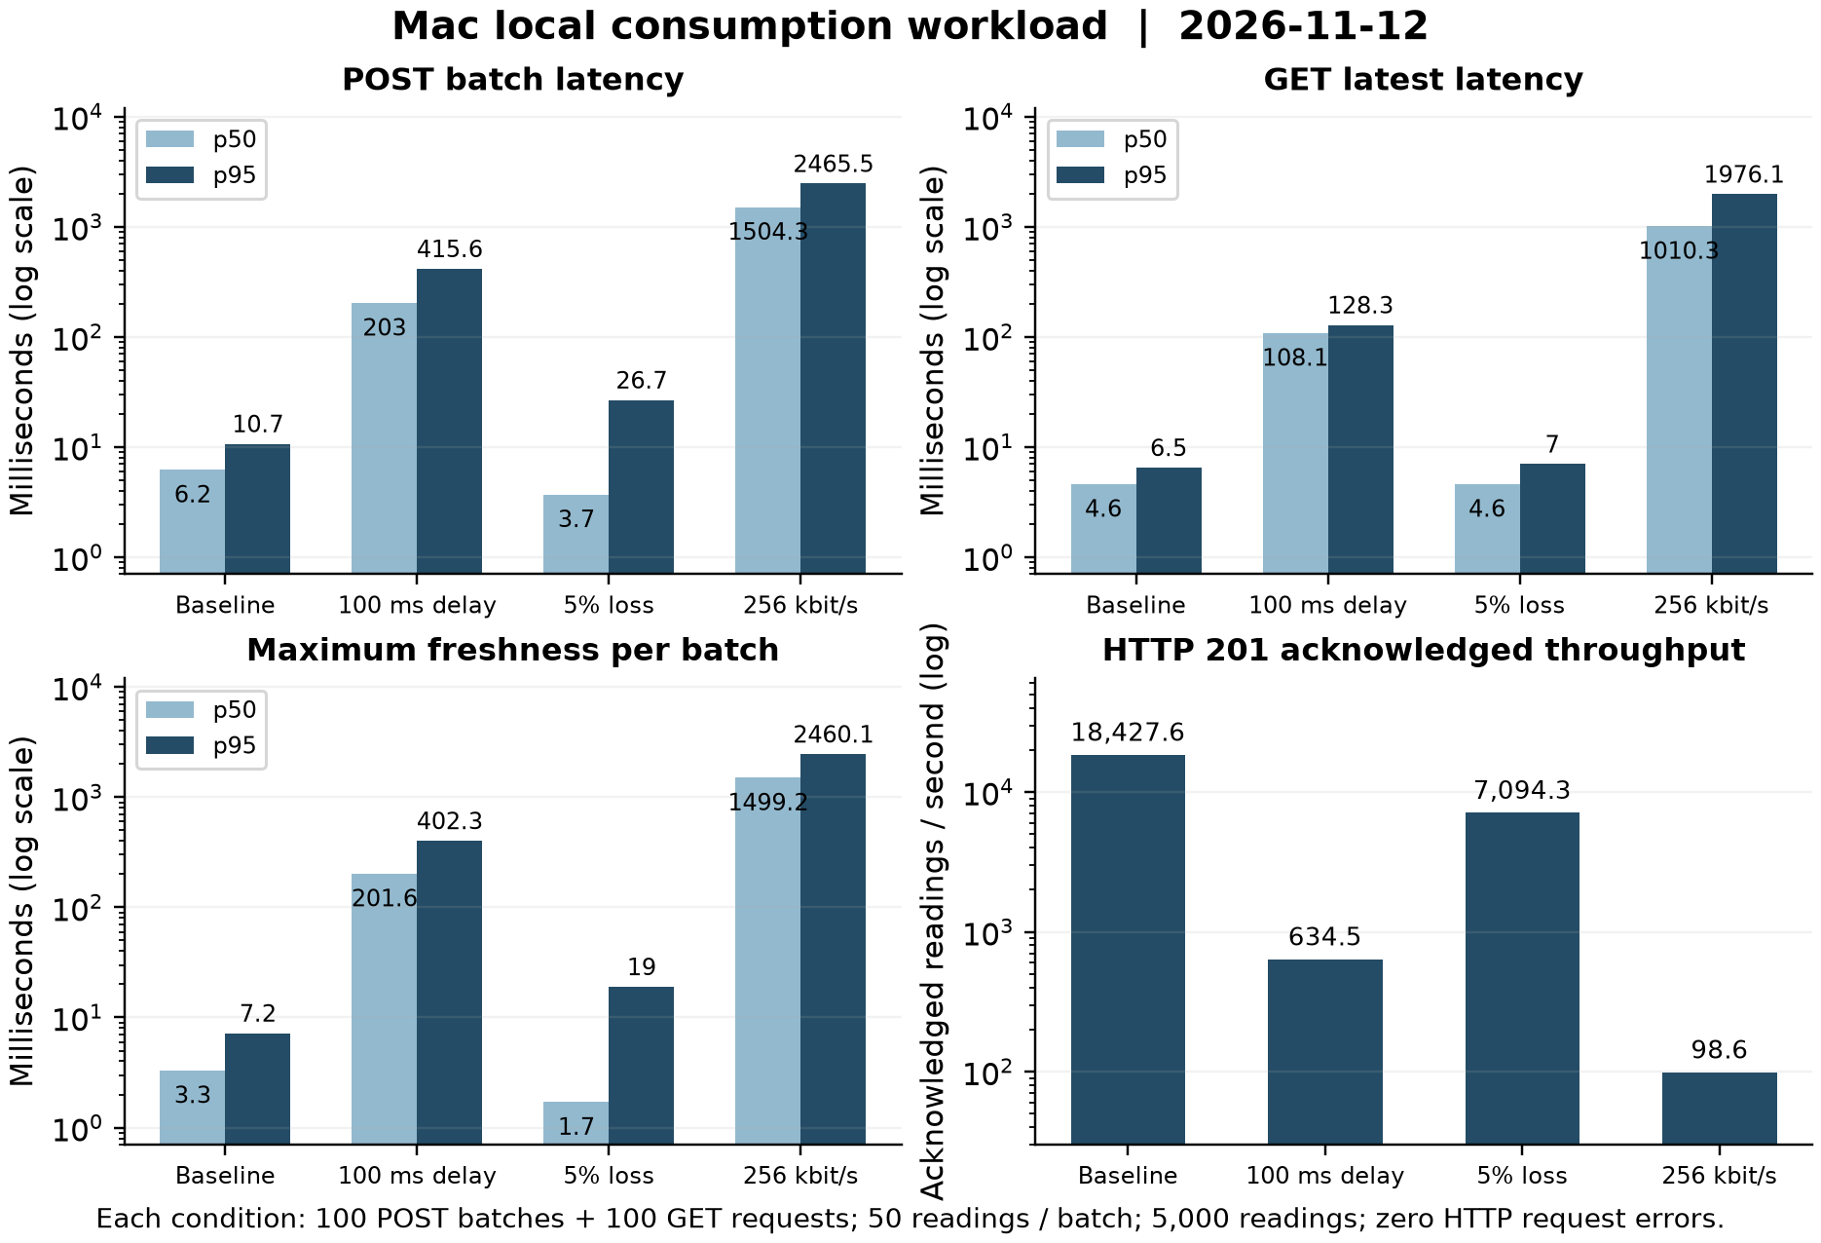
Performance Results
Module E · Performance
POST p50
Baseline 4.2 ms · 100 ms delay 203 ms · 5% loss 3.7 ms · 256 kbit/s 1,504 ms
Throughput
18,428 readings/s baseline vs 98.6 readings/s at 256 kbit/s
Each condition: 100 POST batches, 50 readings per batch, 5,000 readings, zero HTTP errors
Notes:
Heads up, the charts use a log scale. Delay adds the extra round trips, loss mostly hurts the tail, and the 256 kbit/s cap is the real bottleneck.

Slide 7
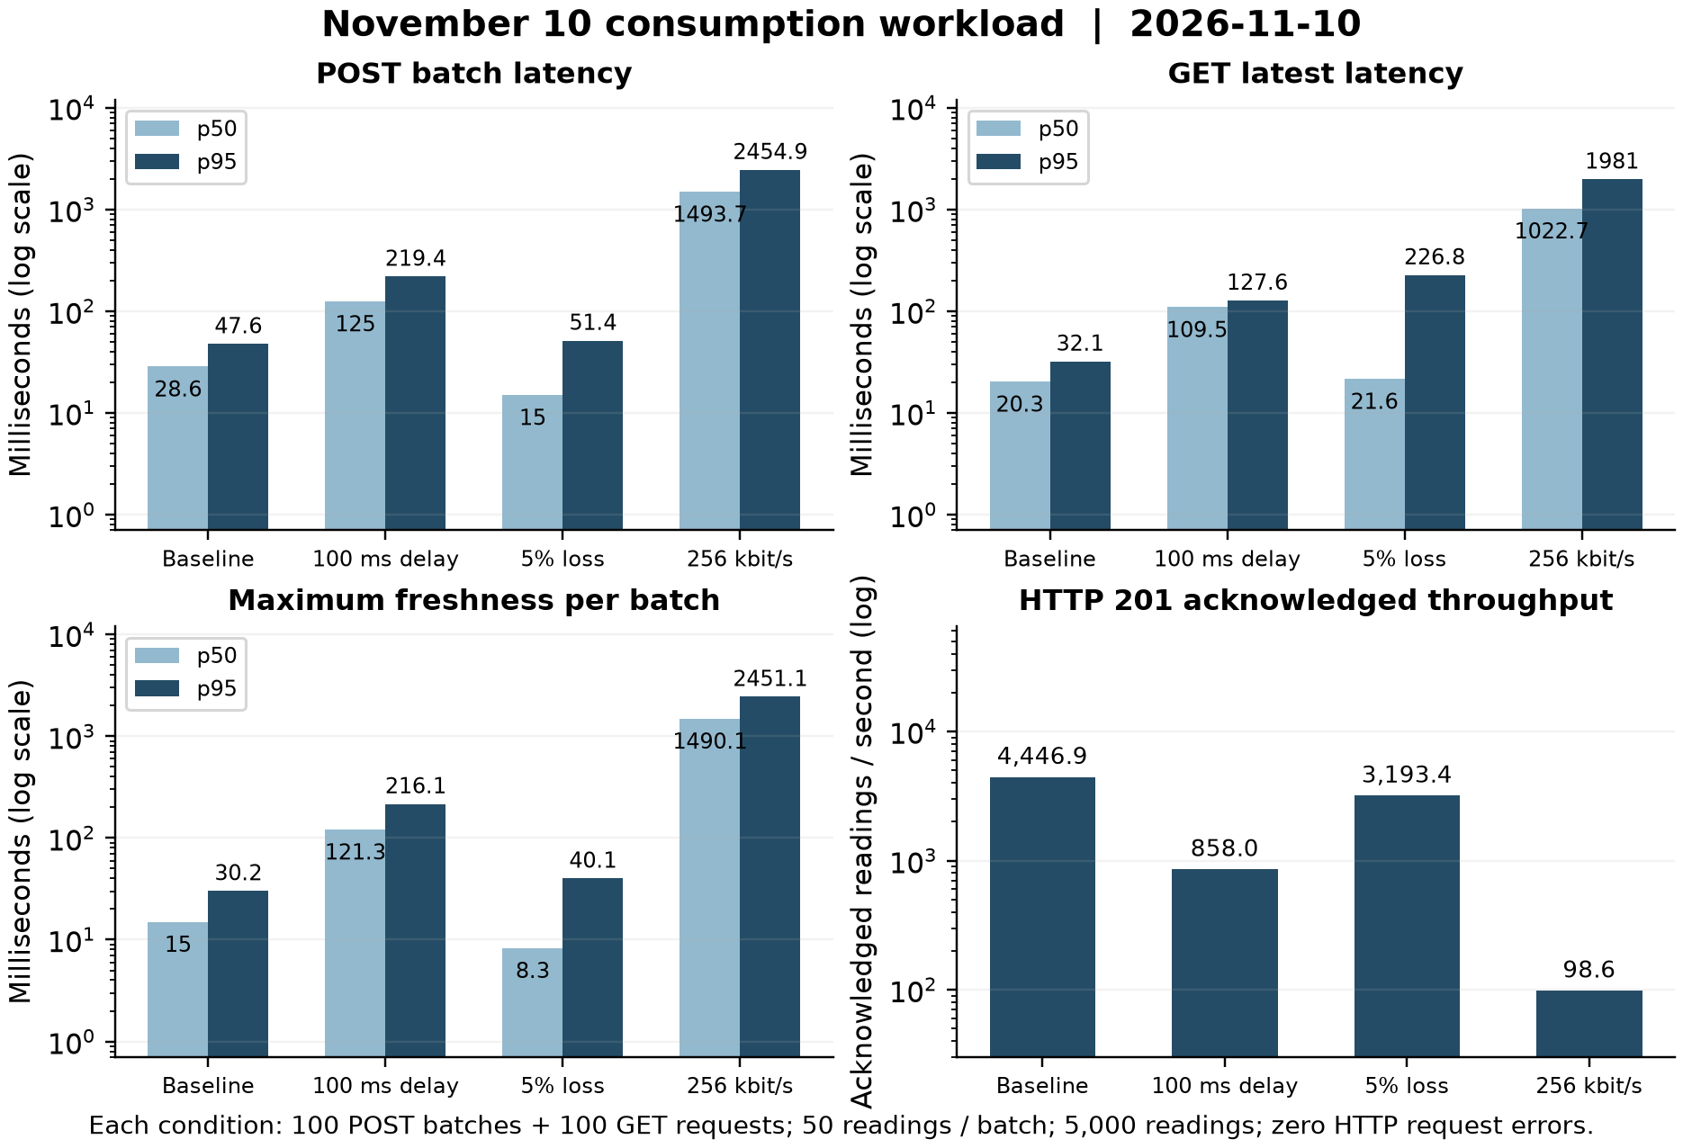
Throttled Link Experiment
Option 09 · Throttled link
We got 98.6 readings/s at 256 kbit/s in both runs, so the limit comes from the link
All 5,000 readings still arrived with zero errors
Freshness per batch grows to about 1.5 to 2.5 s at the cap
Notes:
This is the Option 09 effect. Throttling slows the data down but we lost nothing. We ran it twice and got the same throughput at the cap, so it comes from the rate limiter.

Slide 8
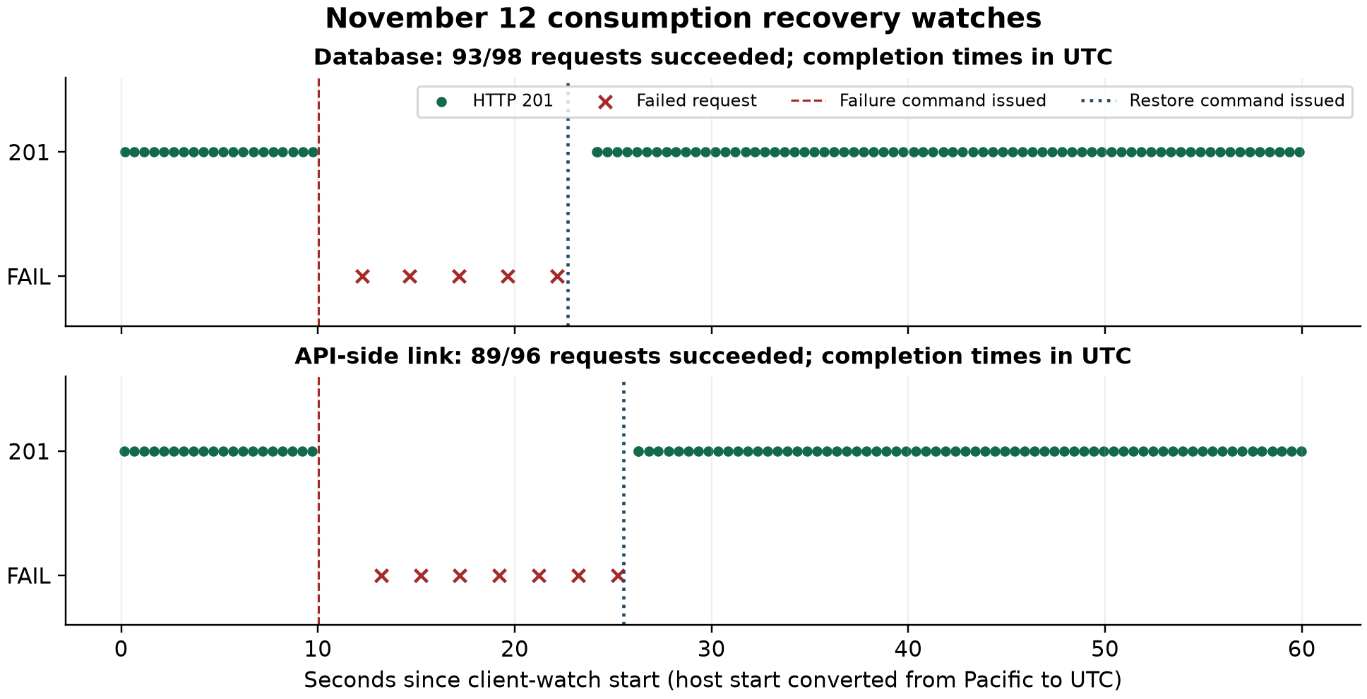
Failure and Recovery
Module F · Failure and recovery
Database stop
93 of 98 requests worked, and failures stopped after we restored it
API link cut
89 of 96 requests worked, and it came back after the restore
Notes:
Read it left to right. Green is normal 201s, then red failures after we ran the failure command, then normal again after the restore. fail_recover.sh does both cases.

Slide 9
Automation
Module F · Automation
deploy.sh
healthcheck.sh
firewall.sh · impair.sh
Builds and starts the four containers
13 checks across router, API, TLS and firewall
Apply rules and tc/netem delay, loss, rate
experiments.sh
capture.sh
fail_recover.sh
Runs baseline, congested and failure states
tcpdump evidence for Wireshark
Failure injection and recovery watch
Notes:
One command per stage. A reviewer can reproduce the run from a fresh clone.

Slide 10
Limitations
Honest scope
Self-signed certificate, no real CA or mutual TLS
One copy of each service, so no high availability
Link problems are emulated on one machine, not a real WAN
The solar data is synthetic and we only imported 20,000 UCI rows
Throughput numbers will differ on other machines
Notes:
We want to be upfront about these. They were scope choices for a course project.

Slide 11
Lessons Learned
Takeaways
Segment first
Measure it
Automate the evidence
A default-drop router makes the allowed path clear and easy to test
The rate limit hurt way more than delay or loss for this workload
Scripts turn a demo into something others can reproduce
Notes:
Three takeaways, one line each.

Slide 12
Team and References
Team and references
References
Team
Hebrail and Berard, UCI Household Electric Power Consumption, CC BY 4.0
Repository: github.com/TeagenLee/csci414-energy-grid
Chidera Izuora · Teagen Lee · Yohannes Nigusse
Roles to be confirmed against the git history
Notes:
Close with the team, repository link and dataset credit. Invite questions.

